Slide 1


SAP UI5 & FIORI with OData TRAINING
Anubhav Oberoy
Day – 12

Slide 2

Agenda – Day 12
Introduction to Router and Routing
Understanding the use of Route Match Handler
Using SAP mobile table
Working with Messages in UI5
Introduction to Fragments in UI5
Understanding ways of using fragments
Using Fragments and Popup/Value Help
Basics of OData
Perform OData Calls on Northwind service
Introduction to Fiori System Architecture
Important Tcodes in SAP Logon
Structure of Data Model for our use case
Creating Odata Service.
Steps by Step Process to Create Odata service.
Introduction to Runtime Artifacts
Implementing Get Entity and EntitySet Methods.
Introduction ot Postman Tool.

Slide 3

Exercise: Routing
In this exercise we will add router to our application we will also see how to add routing configuration in the manifest.json file.
To Enable routing we have to initialize the router in Componenet.json file. Along with that we have to remove the Create content function form the Componenet.json file.
We will also add a new view in the application named as empty view.
For now we will implement the router without binding the view with the path.
Exercise code/resource:-
manifest.json
Component.js
View1.controller.js
Empty.view.xml
Empty.controller.js

Slide 4
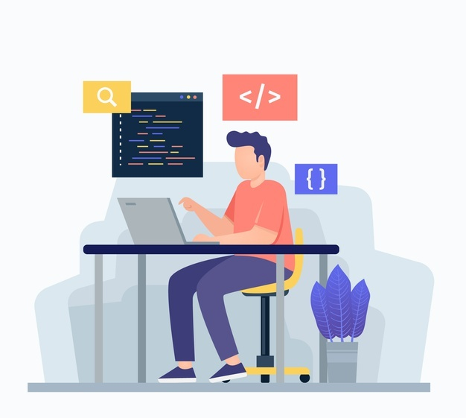
Route Match Handler
SAPUI5 offers a hash-based navigation, which allows you to build one-page apps where the navigation is done by changing the hash, so the browser does not have to reload the page. Instead there is a callback to which the app and especially the affected view can react. This callback is known as Route Match Handler.
Route Match Handler is called every time when the route is triggered.
Exercise code/resources:
View1.controller.js
View2.controller.js
manifest.json

Slide 5
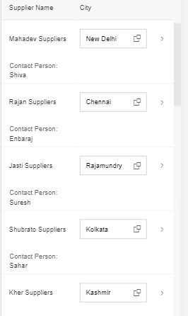
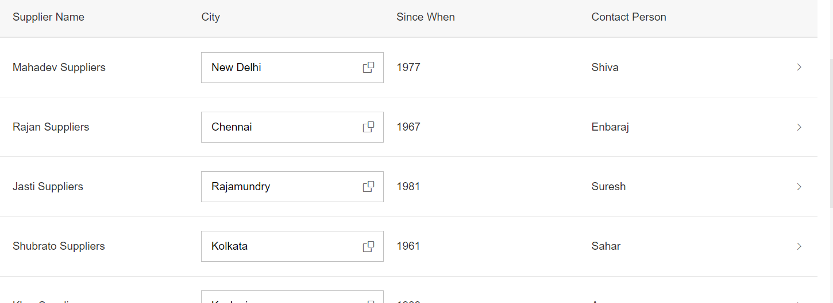
Working with Mobile Table
The responsive table is the default table in SAP Fiori. It contains a set of line items and is fully responsive. Depending on the scenario, users can also navigate from the line items to further details.
The responsive table is optimized for viewing one line item at a time with no scrolling or only vertical scrolling, irrespective of the display width.
On smartphones, only the most important data remains in the one-column or two-column table, while all other data is moved to the space between two item rows, known as the “pop-in area”.
In this area, data for the corresponding cell is provided as a label/value pair. The label is defined by the column header, and the value is taken from the corresponding cell. Labels can be displayed next to the value or above the value.

Slide 6
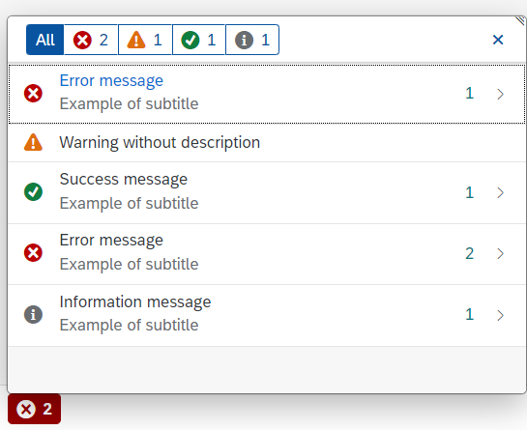
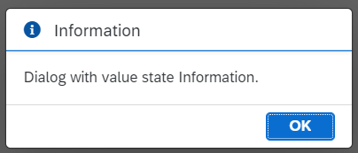
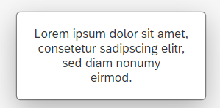
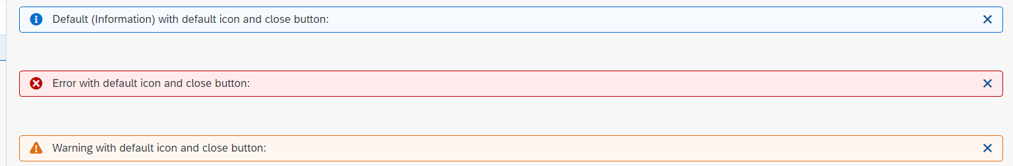
Working with Messages
The system generates messages in response to what users do in the SAP system. A message presents information, an instruction, or a warning to users in a given situation.
Messages can be used to notify the user about specific states of the application and can help the user to correct their incorrect inputs.
For showing messages to the user that are related to the current page, you have several possible controls. Each of these offers a different type of interaction from the user. Choose the control that fits best in you interaction pattern.
Message Dialog: A message dialog interrupts the user's workflow by blocking the current page and needs to be closed by the user.
Message Toast: A message toast is an overlay that disappears after some time or if the user taps somewhere else. It does not block the user.
MessageStrip: MessageStrip enables the embedding of short application-related messages in the application. There are four types of messages and each is color-coded and has an icon corresponding to its type: Information, Success, Warning and Error.
MessagePopover: MessagePopover displays a summarized list of different types of messages (errors, warnings, success and information). It provides a handy and systemized way to navigate and explore details for every message.

Slide 7

Exercise: Mobile Table and Message Toast
In this exercise we will add a Mobile table in the supplier section of the Icon tab bar. In the header of the Table we will add a filter button. On click of that button we will display a some messages.
Exercise code/resource:
View2.view.xml
View2.controller.js

Slide 8
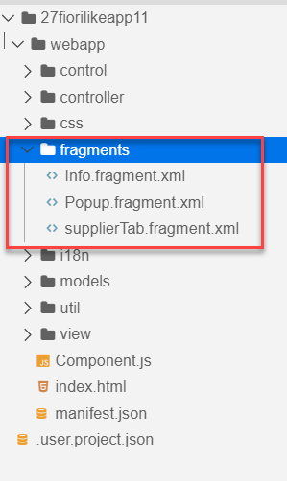
Fragments
Fragments are light-weight UI parts. They are used to modularize views. We can reuse a fragment multiple times in same view or other views.
This class acts as factory which returns the UI control tree defined inside the Fragments.
Fragments are used similar as sap.ui.core.mvc.Views, but Fragments do not have their own controllers. Logic related to fragment’s UI elements is written in the host view’s controller.
Fragments are used similar as sap. ui.
Do not call the Fragment constructor directly!
Use-cases for Fragments are e.g.: - Modularization of UIs without fragmenting the controller structure - Re-use of UI parts - 100%- declarative definition of Views.
Constructor of Fragment is new sap.ui.core.Fragment()
View
View
Popup
Fragment
Popup
View
View
Popup

Slide 10
Loading Fragments in the View
There are two ways of loading filters in the view.
Including the fragment directly into the XML View using the sap.ui.core.Fragment class
Ex: <core:Fragment fragmentName="mynamespace.fragment.FragmentName" type="XML" />
Loading the fragment using the controller on an event. Like for Value Helps.
Steps to load the Fragment using the controller. (without using promise)
Frist we have to create a Fragment Object. To create the object we can use the following method.
var oFragment = sap.ui.xmlfragment(“id”, “namespace.fragment.FragmentName”, controllerObject);
Now Attach the fragment dependent to the view.
this.getView().addDependent(oFragment);
Now open the fragment.
oFragment.open();
Steps to load the Fragment using the controller (with promise).
First we need to include the Fragment dependency in the controller.
'sap/ui/core/Fragment’,
2. Load the fragment using the method
Fragment.load({id: ‘’, name: ‘’, controller: ‘’}).then(function(oFrag){
//code to open the fragment
});

Slide 11

Exercise: Fragments
Part 1: Loading the Fragment in XML View
In this exercise we will move the code in Icon tab bar to different fragments.
Then load those fragments directly into the XML view.
Exercise code/resource:-
View2.view.xml
Cities.fragment.xml
MoreInfo.fragment.xml
SupplierTab.fragment.xml
Part 2: In this part we will load the fragment form the controller.
Now we will make a new fragment for the Suppliers. This fragment will open when we click on the filter button as a value help.
Also we will filter the table according to the selected filter.
Also we will make a value Help for city in table.
Exercise code/resource:-
View2.controller.js
SupplierTab.fragment.xml
popup.fragment.xml

Slide 12
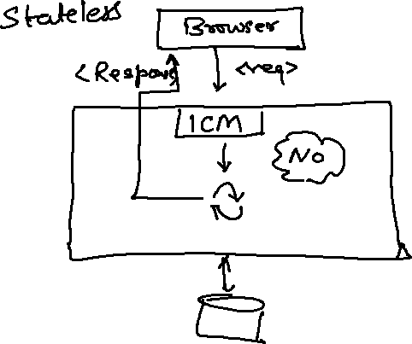
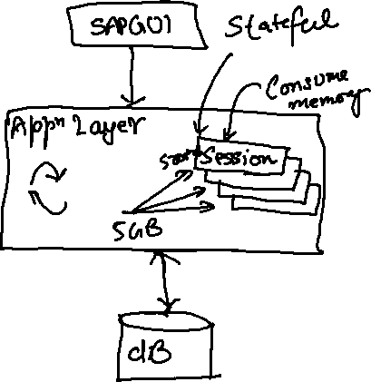
What is OData?
OData Stands for Open Data Protocol, it is an OASIS standard to communicate to server using REST based service. It was acquired by Microsoft in 2012 and adopted by many companies to build REST services to expose data over internet HTTP/HTTPs protocol.
Funda Fox
Fiori cannot talk to FM, program, CDS views, …. Fiori only and only talk to OData service which is built on top of FM, ABAP code, CDS view.

Slide 13
OData Basics
This OData Protocol is mainly used to expose data over HTTP. It does not matter from consumer point, which technology the OData is built on. This way we are abstracted from the underlaying programming/database. Fiori only and only understand OData, it cannot talk to BAPI, BADI, FM, CDS View, Interface, Class.
Lets start understanding a sample odata given by Microsoft on odata.org
1. Service document – is a collection of entity sets to access the data.
An Entity set is built by an Entity Type. Entity Set is the right end point to perform CURDQ operations
Entity Type describes the structure of the data – metadata
https://services.odata.org/V3/Northwind/Northwind.svc/
2. Service metadata document – describes all the properties and entity types
Which includes key, properties, attributes (nullable, key, max length, create), NavigationProperty
Also includes the relations between entities called association (compare with Foreign key)
Usually one database table is considered as one entity.
https://services.odata.org/V3/Northwind/Northwind.svc/$metadata
https://chrome.google.com/webstore/detail/jsonview/chklaanhfefbnpoihckbnefhakgolnmc
https://chrome.google.com/webstore/detail/xml-tree/gbammbheopgpmaagmckhpjbfgdfkpadb

Slide 15

Structure of an OData URL
http://stcfin.st.com:8021/sap/opu/odata/IWBEP/GWSAMPLE_BASIC/ProductSet?$format=json
http(s)://hostname:port/sap/opu/odata/sap/SERVICENAME_SRV/ENTITYSET?p1=val&p2=val
Protocol
Address & Port
Path prefix
Service Name
End Point Access Data
Query Options

Slide 16
Client Side Query with OData
Sets the page size of results.
02
$top
Indexes into a result set. Also used by some APIs to implement paging and can be used together with $top to manually page results.
Returns the results in the specified media format.
01
03
$format
$skip
ODATA Query
06
04
Retrieves related resources.
Filters properties (columns).
$expand
$select
05
$filter
Filters results (rows).

Slide 17
GET operations
Read All the data from Products (SELECT * FROM dbtab)
https://services.odata.org/V3/Northwind/Northwind.svc/Products?$format=json
Read few properties of entity (SELECT col1, col2 FROM dbtab)
https://services.odata.org/V3/Northwind/Northwind.svc/Products?$format=json&$select=ProductID,SupplierID
Read Top Records (Pagination SELECT * UP TO ROWS n ..)
https://services.odata.org/V3/Northwind/Northwind.svc/Products?$format=json&$top=3&$skip=10
Read data by filtering (SELECT * FROM dbtab WHERE condition)
https://services.odata.org/V3/Northwind/Northwind.svc/Products?$format=json&$filter=SupplierID%20eq%203
SELECT * FROM dbtab WHERE col LIKE ‘%pattern%’
https://services.odata.org/V3/Northwind/Northwind.svc/Products?$format=json&$filter=substringof(%27Cola%27,ProductName)%20eq%20true
Reading count of the records (SELECT COUNT(*) FROM dbtab)
https://services.odata.org/V3/Northwind/Northwind.svc/Products/$count
Reading Single record by its key (SELECT SINGLE * FROM edbtab WHERE pkey = ‘key’)
https://services.odata.org/V3/Northwind/Northwind.svc/Products(11)?$format=json
Join and read data together (SELECT * FROM tab1 INNER JOIN tab2 ON cond)
https://services.odata.org/V3/Northwind/Northwind.svc/Products(11)?$format=json&$expand=Supplier,Category

Slide 18
SAP Fiori System Architecture
Presentation Layer
SAPGUI/Browser
Presentation Layer
SAPGUI/Browser
Fiori Apps
[new]Fiori Frontend Server
Like a HUB/Switch
services
OData services publish
Embedded System (LOCAL)
Services, Reg.,Publish, Fiori Apps, Launchpad, Designer, Apps, Code, ABAP Code
Fiori launchpad
RFC(SM59)
Existing ECC/App Layer
Fiori Backend Server
SAP CRM
SAP PLM
Development of service code
SAP HCM
SAP SRM

Slide 19
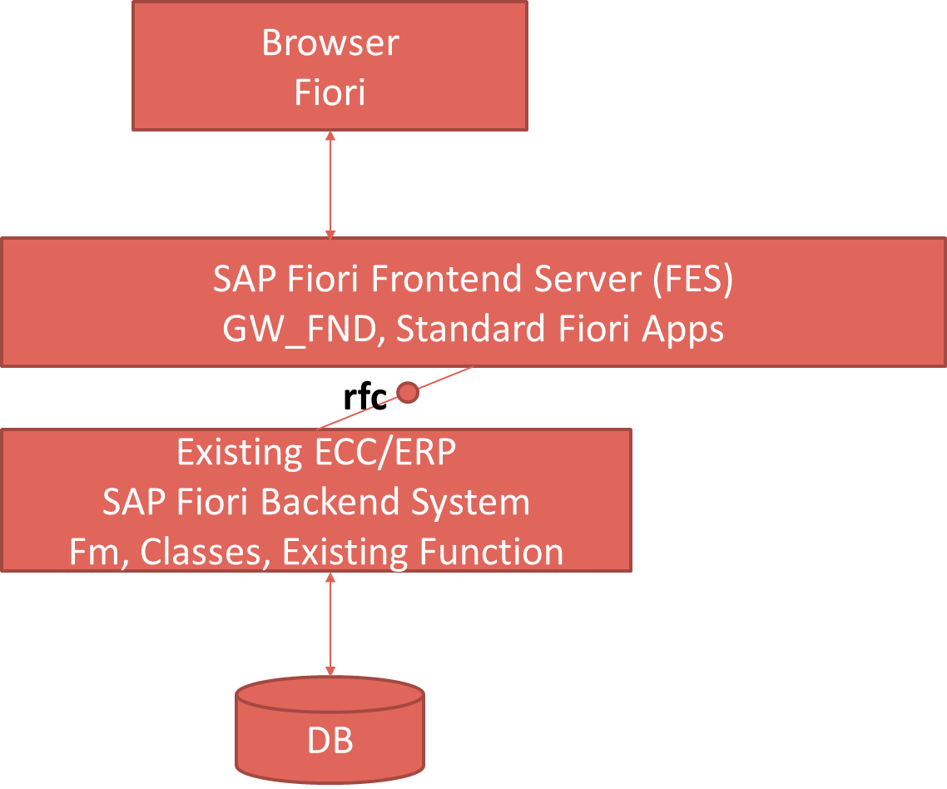
Pros and Cons
Central HUB Deployment
Cons:
Manage multiple systems
Cost is high
Confusion
User needs to be duplicated
OData Metadata is duplicate
Pros
No need to upgrade
Separation of concerns
Works like a HUB
Embedded Deployment (recommended)
Pros – Less Costly, no confusion, No redundancy
Cons – Upgrade
Recommendation
https://www.sap.com/documents/2018/02/f0148939-f27c-0010-82c7-eda71af511fa.html
S/4HANA
CRM

Slide 20
TCodes and Service
SEGW – SAP Service Gateway Builder
/n/IWFND/MAINT_SERVICE – Register the service
/n/IWFND/GW_CLIENT – gateway client – test locally
/n/IWFND/ERROR_LOG – Check errors, troubleshoot
EPM – Enterprise procurement model – Demo data model given by SAP for Training and demonstration.
ITeIO
SO
Customers
PO
Suppliers
Invoices
Stock

Slide 21
Data Model for our use case
EPM Data model = Enterprise Procurement Model
This is a sample data model for learning and education purpose since it is a demo model, we are not risking any productive objects in our system. The data model has
All the BAPI starts with BAPI_EPM*
Products (SNWD_PD, SNWD_TEXTS)
BAPI_EPM_PRODUCT_GET_LIST – All the list of products
BAPI_EPM_PRODUCT_GET_DETAILS – Read single product by key
BAPI_EPM_PRODUCT_CREATE – Create new product
BAPI_EPM_PRODUCT_DELETE – Delete product
BAPI_EPM_PRODUCT_UPDATE – Change data of a product
Business Partners (SNWD_BPA)
BAPI_EPM_BP_GET_LIST – All the list of Business Partners
BAPI_EPM_ BP_GET_DETAILS – Read single Business Partners by key
BAPI_EPM_ BP_CREATE – Create new Business Partners
BAPI_EPM_ BP_DELETE – Delete Business Partners
BAPI_EPM_ BP_UPDATE – Change data of a Business Partners
Orders (SNWD_SO, SNWD_SO_I)

Slide 22
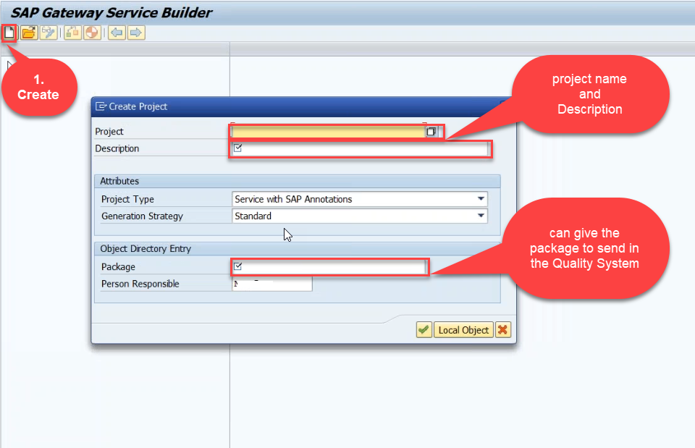
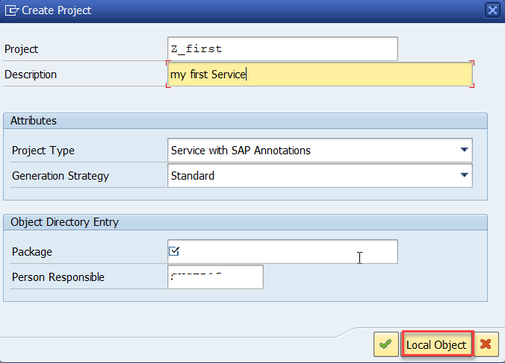
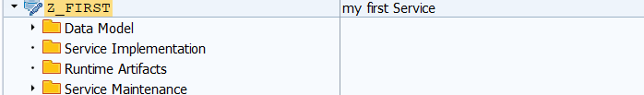
Creating OData Service
Step1: Start your SAP LOGON, and to Sap Gateway Service Builder(SEGW) and click on Create

Slide 24
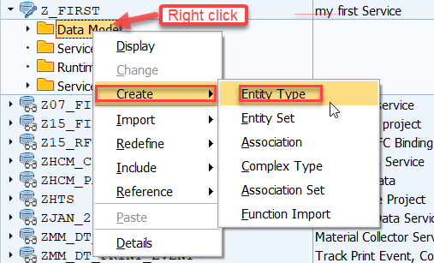
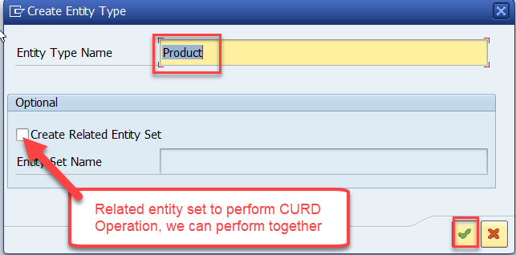
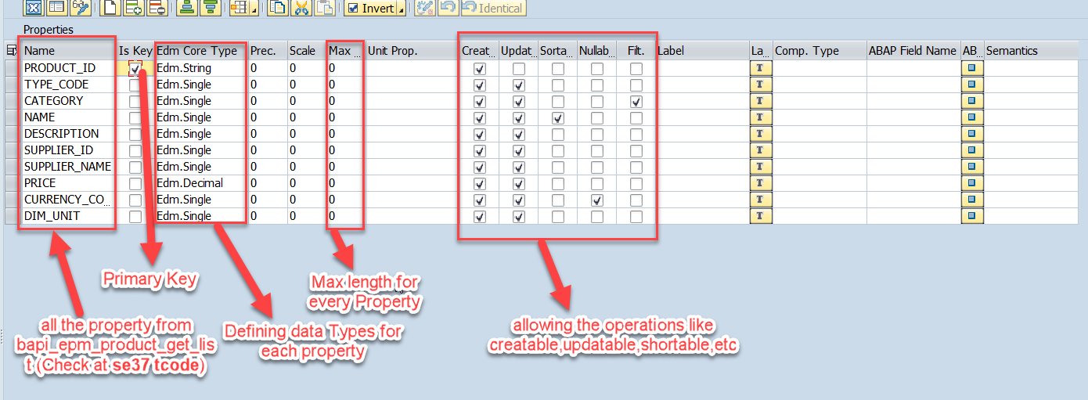
Creating OData Service Continue…
Step2: Defining the Data Model (Blueprint of data)
Step3: Creating Properties for data model (from bapi_epm_product_get_list (TCode- se37))

Slide 25
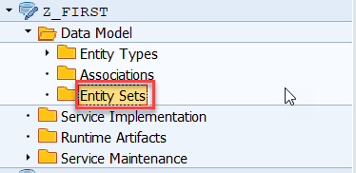
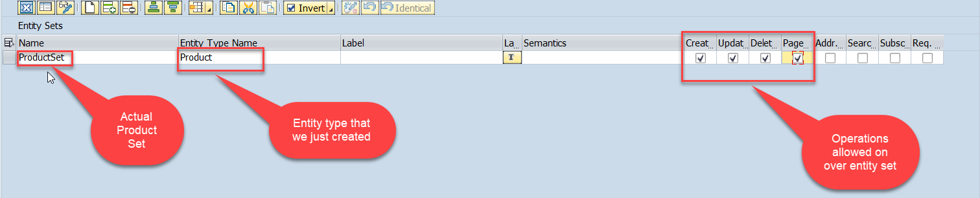
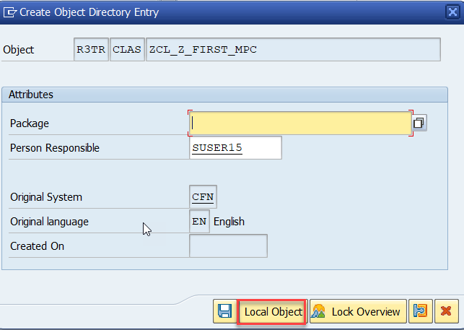
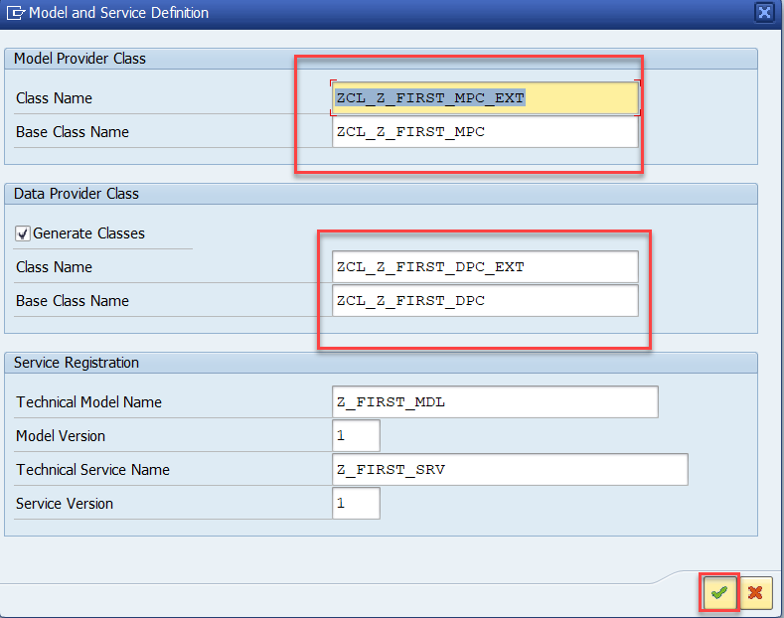
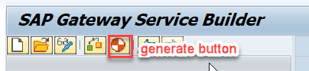
Creating OData Service Continue…
Step4: Creating entity set to perform actual CURD operations and service generation.

Slide 26
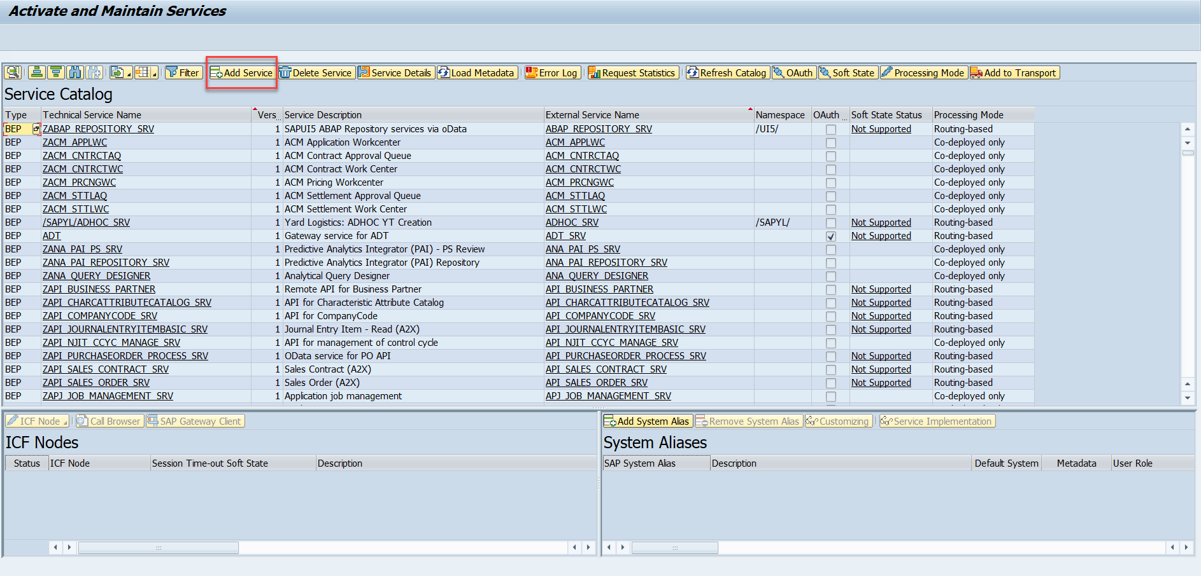
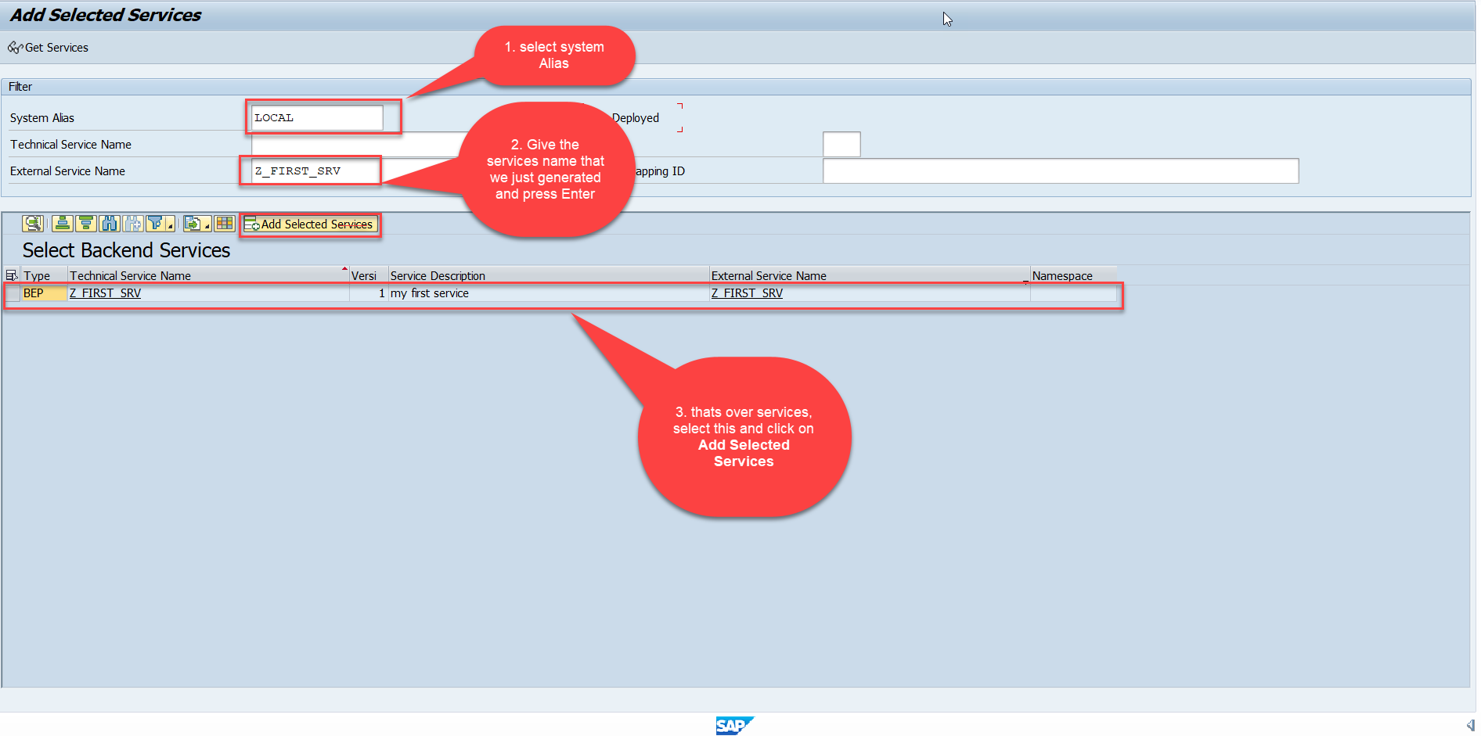
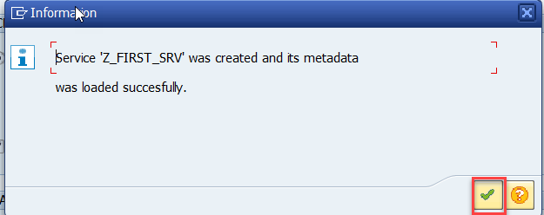
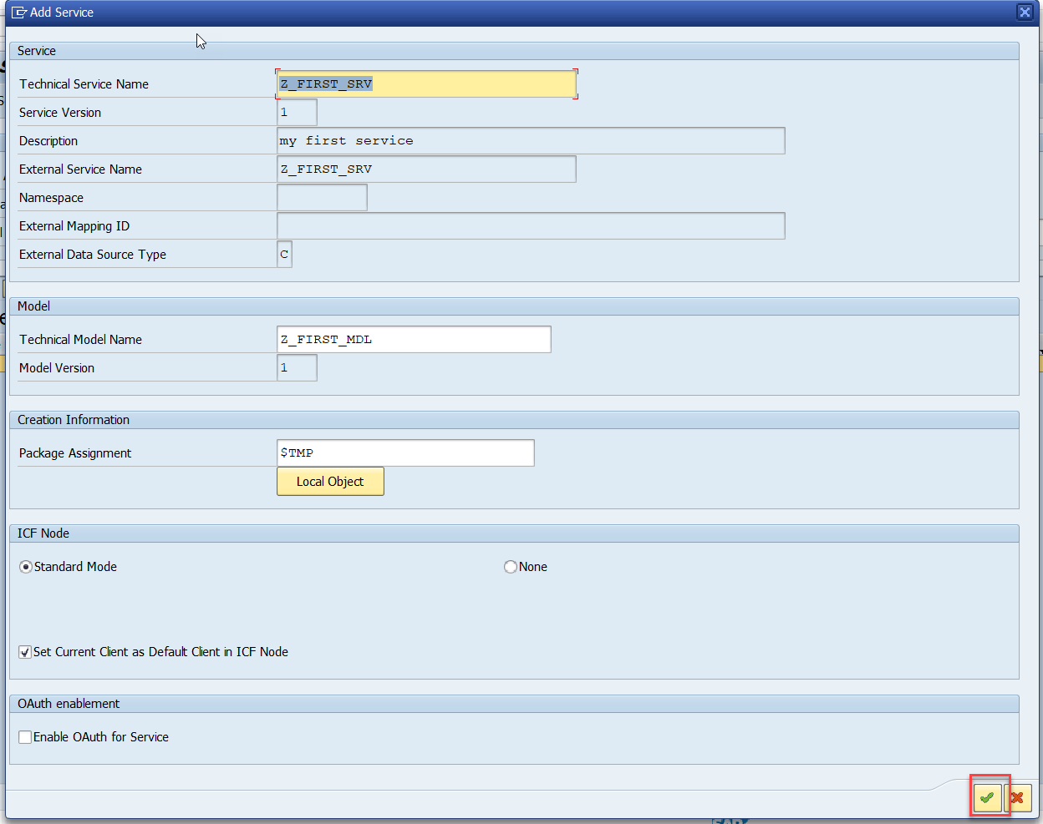
Creating OData Service Continue…
Step5: Service Registration (Go to tcode- /iwfnd/maint_service)

Slide 27
Runtime Artifacts
When we create a service there are 2 types of code which developer/system needs
Metadata code – which serve metadata of the service, will be generated by system automatically every time we change the service a new code will generate overwriting old code by SAP. This code is generated in MPC – model provider class
MPC = Model Provider Class (metadata) = where all the abap code will be generated which will have the code for metadata
Service Code – which is required as service implementation for performing CURDQ functionality. This code will be written by developer in a class called DPC = Data provider class.
DPC = Data Provider Class (data operations CRUDQ) = Contains all the implementation of CURDQ. It will get for each entityset 5 methods.
What if a developer need to customize the SAP generated code
SAP
Model provider class MPC class
Data Provider class
DPC class
Metadata
Types of entities
PROJ_SRV
Each entity 5 methods will be created –
OBJECT_GET_ENTITYSET
OBJECT_GET_ENTITY
OBJECT_CREATE_ENTITY
OBJECT_UPDATE_ENTITY
OBJECT_DELETE_ENTITY
MPC_EXT
Here we should write our code
DPC_EXT
CURD Functionality

Slide 28
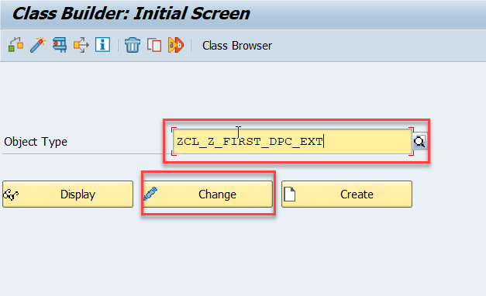
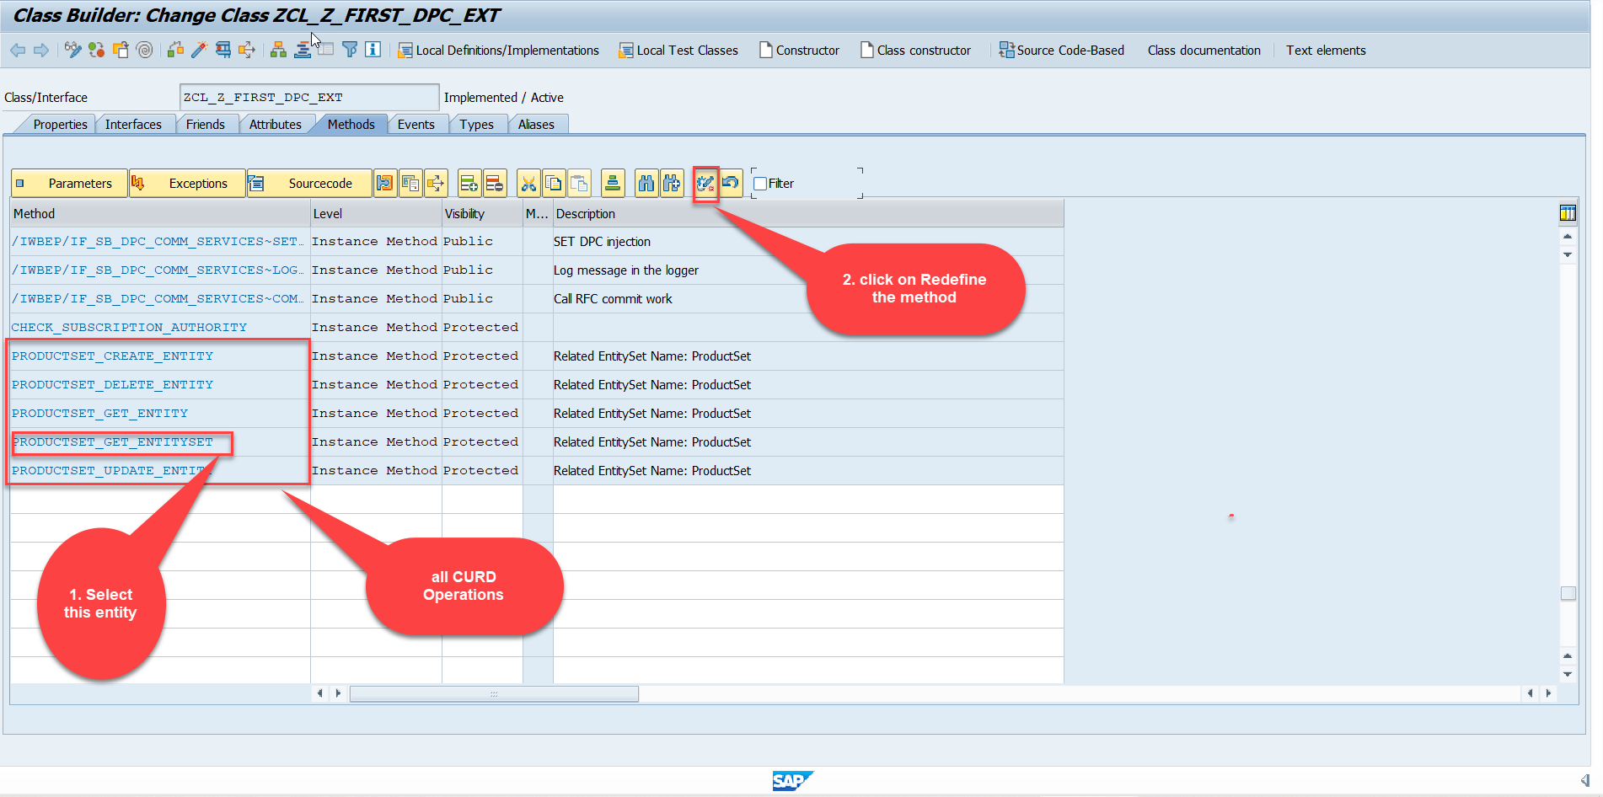
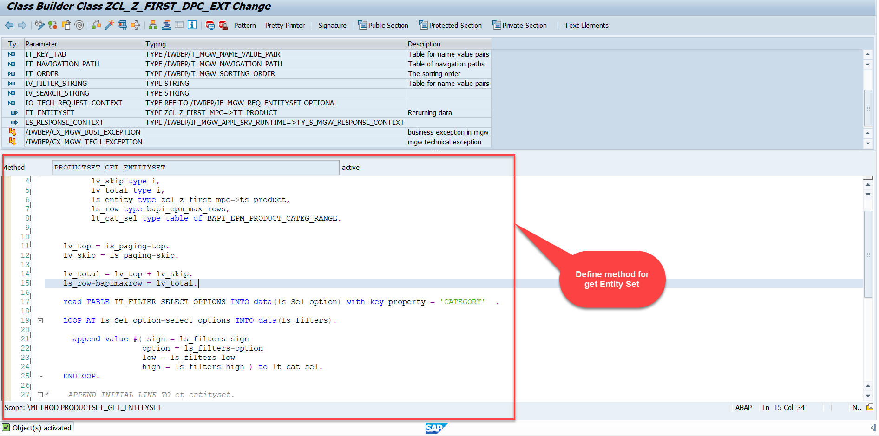
Building GetEntitySet Method
Step1: ProductSet Get Entity method(with filter, top and skip) in DPC Extension (Class Builder tcode- se24)
Code:
GetEntitySet

Slide 29
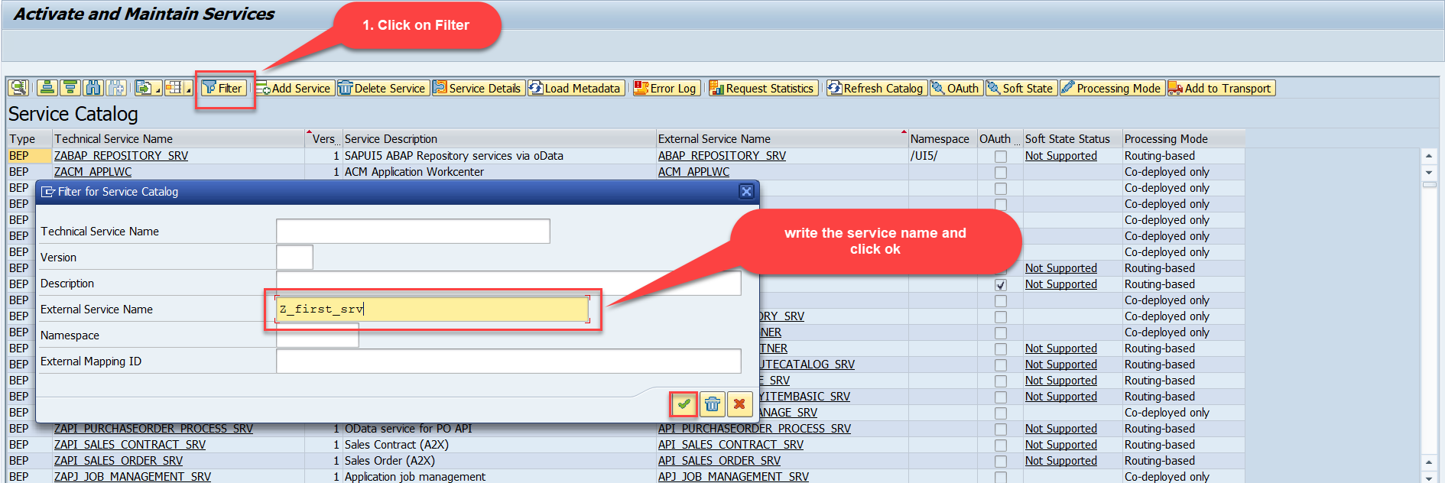
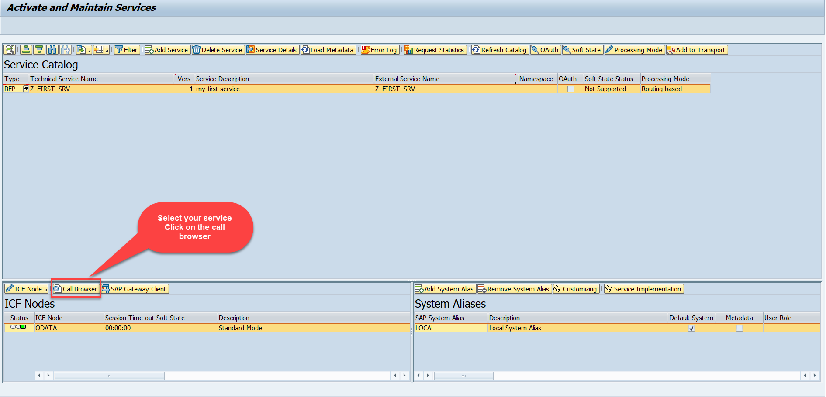
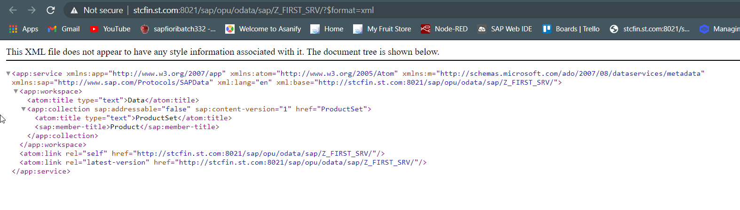
Building GetEntitySet Method Continue...
Step2: Call the service to the browser that we just created (go to service maintain (/iwfnd/maint_service))
Service in Browser

Slide 30
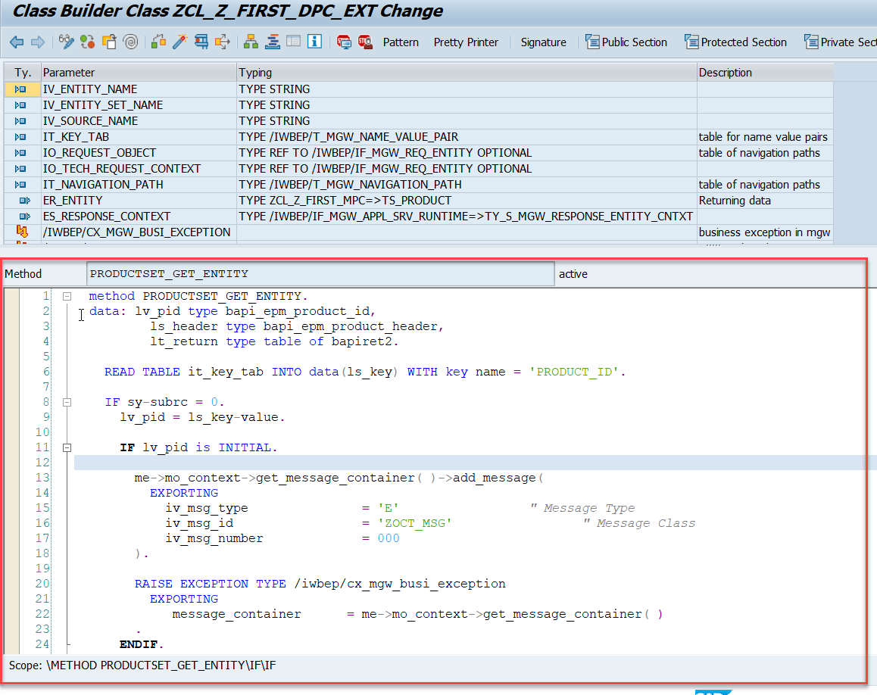
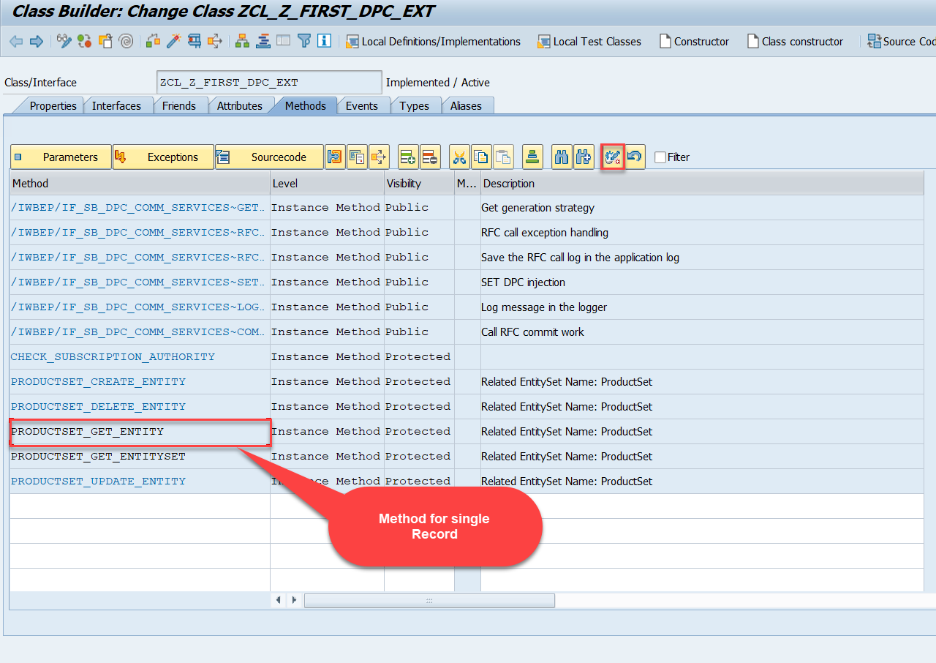
Building GetEntitySet Method Continue...
Go to DPC Extension of over service and redefine the method PRODUCTSET_GET_ENTITY
Code:
GetEntity

Slide 31
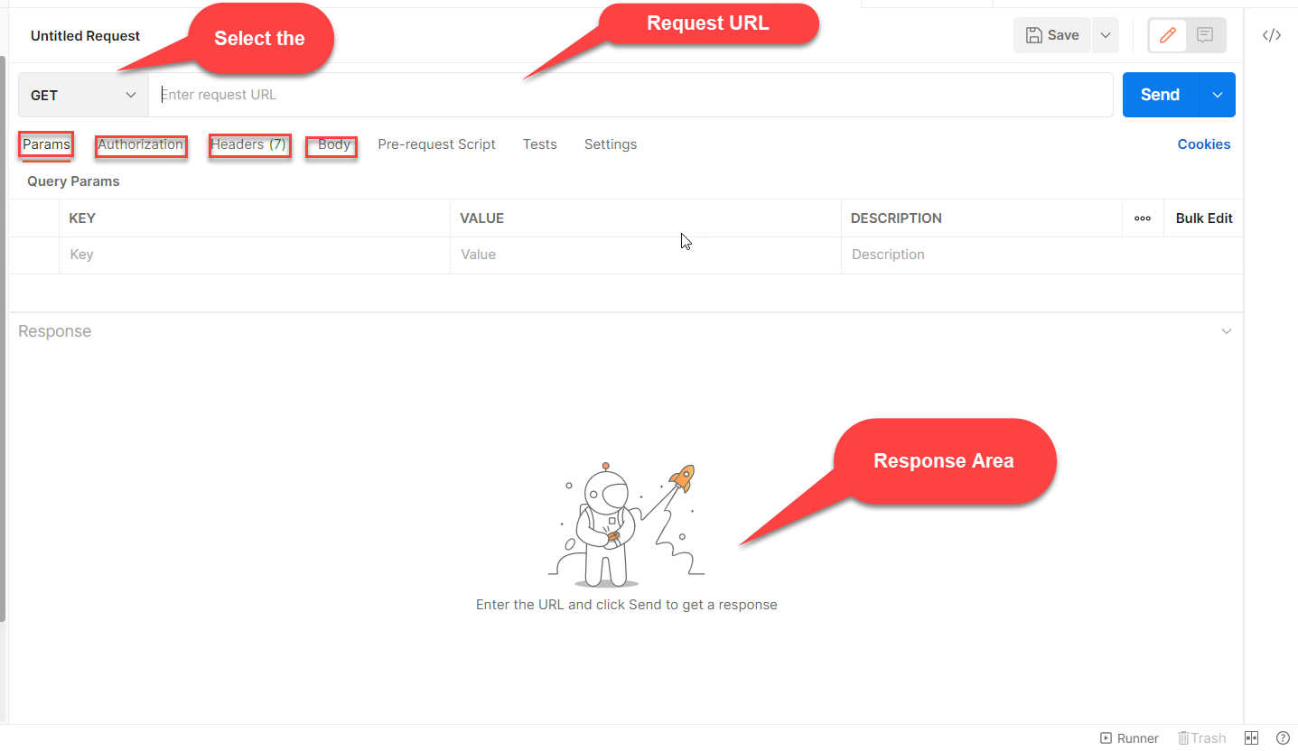

Postman
Postman is a free tool which can be used to test any kind of REST/OData Services outside of the system. This allows us to consume the data as if an external consumer would really do.
Postman is an API platform for building and using APIs. Postman simplifies each step of the API lifecycle and streamlines collaboration so you can create better APIs—faster.
As an ABAP developer, you can develop postman collection and deliver it to Fiori Developers for consumption to showcase, what our service is capable of.

Slide 32

End of Day 12

Slide 33

Questions

Slide 34

Anubhav Oberoy

Slide 35


We’re committed to empower you to be
Most Desirable Resource
through powerful training solutions.
We build the workforce of the future.
250+
Corporate Clients
30,000+
Learners Trained
25000+
Learners Placed
FREE WEBINARS
Sign up for free webinars with industry experts every fortnight!
Enroll Now!
Contact us today!
https://anubhavtrainings.com/

Slide 36




More from AnubhavTrainings.com

Slide 37
Title
Content

